Slide 1
Freedom or Slavery?
Presented by: Muhammad Shakeel & Muhammad Adeel

Slide 2
Is Pakistan Truely what it was Meant to Be?

Slide 3
Pakistan is An Islamic State

Slide 4
Any transaction that involves interest will necessarily hurt one of the two sides; it is essentially a gamble, which is also prohibited by Islam. Muslims consider interest as a modern equivalent to Riba; that is an income that is not earned or is unfair.

Slide 5
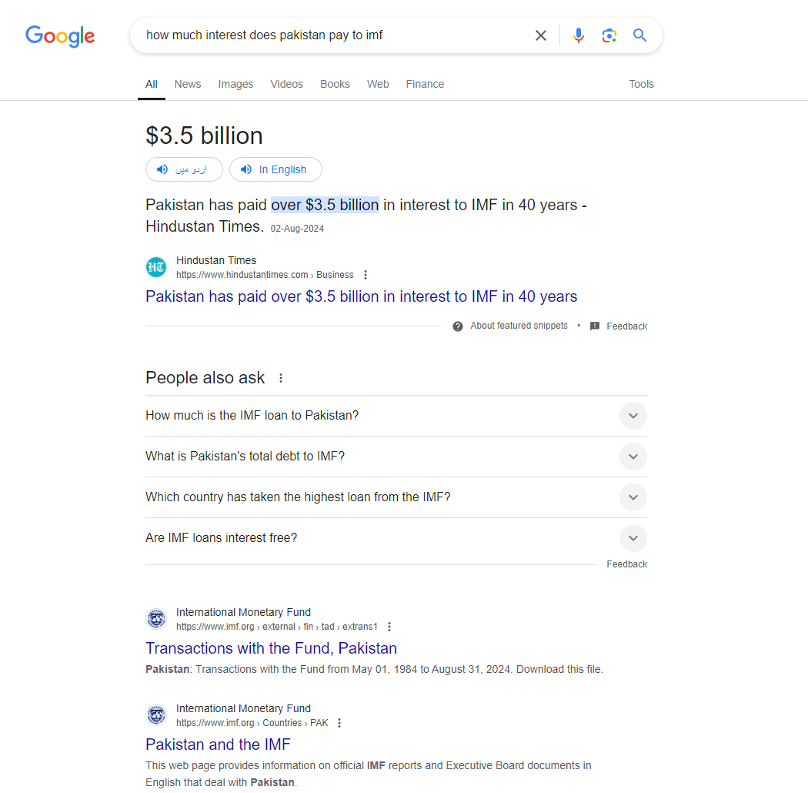

Slide 6


Slide 7
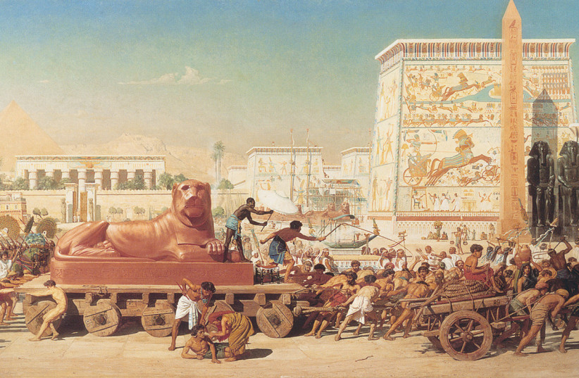
Comparing what Jews did in their times.

Slide 8
How ungrateful we are to Allah now a days?

Slide 9
Why Foreign countries are ahead of us even without Islam?

Slide 10
"Wealth does not necessarily mean that Allah is pleased with someone."
In the Qur'an, the story of Pharaoh (Firaun) is a clear example where wealth, power, and worldly success do not equate to Allah's approval. Despite his immense wealth and authority, Pharaoh was arrogant, rejected the message of Allah, and ultimately faced destruction.
Reference:
Surah Al-Qasas (28:78): "Indeed, Qarun (Korah) was from the people of Moses, but he oppressed them. And We gave him of treasures whose keys would burden a band of strong men. Thereupon his people said to him, 'Do not exult. Indeed, Allah does not like the exultant.'"
Surah Yunus (10:88): This verse highlights the arrogance of Pharaoh and his people, who assumed that their wealth and status would protect them from divine punishment.
These examples from the Qur'an show that worldly wealth and power can be a test and do not necessarily reflect Allah’s pleasure or approval.

Slide 11
Allah tests His servants by both giving and taking to see their faith. The Qur'an mentions:
Surah Al-Baqarah (2:155-156) – Allah tests believers with loss and hardship, and the patient respond with submission.
Surah Al-Ankabut (29:2-3) – Trials distinguish the true believers from those merely claiming faith.
Surah Al-Fajr (89:15-16) – Wealth or hardship are not signs of Allah's favor or humiliation, but both are tests.
These tests refine a believer’s character and faith.

Slide 12
The consequences of leaders not following the Qur'an and the guidance from Allah:
Surah Al-Ma'idah (5:44): Allah says that those who do not rule by His revealed laws are wrongdoers.
Hadith (Sunan Ibn Majah 4019): Prophet Muhammad (peace be upon him) warned that abandoning the Qur'an leads to discord, infighting, and the downfall of nations.
Leaders who neglect Allah's laws are susceptible to internal strife and societal collapse.
Following Allah's guidance ensures justice and stability, while deviation brings chaos and division.

Slide 13
Why Islamic Rules and Regulations are not Being Promoted in Pakistan?
Lack of Awareness and Education:
Many citizens lack a comprehensive understanding of Islamic principles, leading to a disconnection between religious teachings and daily practices.
Educational curricula often prioritize secular subjects over religious education, resulting in a diminished focus on Islamic values.
Influence of Secularism:
The rise of secular ideologies in governance and society has shifted focus away from Islamic laws.
Public policy often reflects Western norms rather than Islamic teachings, creating a divide between the law and religious expectations.
Inconsistent Application of Laws:
Islamic laws are not uniformly enforced, leading to perceptions of injustice and hypocrisy.
Selective enforcement of laws, such as blasphemy laws, can undermine the legitimacy of Islamic regulations.
Cultural Shifts:
Modernization and globalization have introduced new values that sometimes clash with traditional Islamic principles.
Social norms increasingly prioritize individualism over communal and religious obligations.
Need for Revival:
There is a pressing need to reintegrate Islamic teachings into the educational system and public discourse.
Engaging community leaders and scholars can help bridge the gap between religious teachings and everyday life.

Slide 14
Types of Slavery
Physical
Mental
Psychological Slavery:
Definition: This form of slavery involves individuals being mentally manipulated or coerced into accepting subservient roles or beliefs, often without realizing it.
Characteristics: Psychological slavery can manifest through indoctrination, lack of self-esteem, and a belief that one is inherently inferior. Victims may feel powerless, believing they have no options for escape or improvement, which perpetuates their subjugation.

Slide 15
Backlash
Social media, showbiz promoting content that is inappropriate in many sense.
Drama: Jaan Nisar

Slide 16
Sudhar Jao
Manh lo Galti apni B
:)

Slide 17
Thank You!

